Slide 1

Drowsiness Detection System using CNN
SRM INSTITUTE OF SCIENCE AND TECHNOLOGY
COLLEGE OF ENGINEERING AND TECHNOLOGY
DEPARTMENT OF COMPUTING TECHNOLOGIES
18CSP107L - MINOR PROJECT
Guide Name : Dr.Pandiyaraj A
Designation : Assistant Professor
Department : Ctech
Batch ID: B397.a
Fazin Faizal
RA2011003011052

Slide 2
Table of Contents
Abstract
Introduction
Problem Statement
Objectives
Literature Review
Comparison with existing models
Block Diagram
Modules
Conclusion
References

Slide 3
Abstract
Drowsy driving is a major cause of road accidents, accounting for up to 20% of all accidents. Driver drowsiness detection systems (DDDS) are designed to prevent these accidents by detecting the signs of drowsiness in drivers and alerting them to take a break. There are two main approaches to DDDS: vision-based and sensor based. Vision-based systems use cameras to monitor the driver's face and eyes for signs of drowsiness, such as closed eyes, decreased blinking, and head nods. Sensor-based systems use sensors to monitor the driver's driving behavior, such as steering wheel movements, lane deviations, and reaction times.
DDDS have been shown to be effective in reducing drowsy driving. A study by the National Highway Traffic Safety Administration found that DDDS can reduce drowsy driving by up to 50%. However, there are still challenges that need to be addressed in order to improve the accuracy and reliability of these systems. For example, vision-based systems can be fooled by sunglasses or makeup, and sensor-based systems can be affected by environmental factors such as rain or snow.
Continued research and development is needed to overcome these challenges and make DDDS a more effective tool for preventing drowsy driving accidents.

Slide 4
Introduction
Drowsy driving is a major safety hazard, responsible for an estimated 20% of all road accidents. Vision-based driver drowsiness detection systems can help to prevent these accidents by detecting signs of drowsiness, such as closed eyes, decreased blink rate, and lack of focus.
This project reviews a vision-based driver drowsiness detection system that uses a webcam to track the driver's eye movements. The system was trained on a dataset of images and videos of drowsy and not drowsy drivers. The system was able to achieve an accuracy of 90% in detecting drowsiness.
The system has several advantages over other drowsiness detection systems. It is relatively inexpensive to implement and can be easily installed in a vehicle. It is also non-intrusive, as it does not require the driver to wear any sensors.
The system has the potential to significantly reduce the number of accidents caused by drowsy driving. However, more research is needed to improve the accuracy of the system and to make it more robust to different lighting conditions and driver head positions.

Slide 5
Problem Statement
How can we develop a vision-based driver drowsiness detection system that is accurate, robust, and affordable?
How can we improve the accuracy of the system by incorporating more features, such as head pose and facial expressions?
How can we make the system more robust to different lighting conditions and driver head positions?
How can we develop a system that is non-intrusive and easy to use?
How can we evaluate the effectiveness of the system in preventing accidents?

Slide 6
Objectives
To develop a vision-based driver drowsiness detection system that can accurately detect drowsiness.
To improve the accuracy of the system by incorporating more features, such as head pose and facial expressions.
To make the system more robust to different lighting conditions and driver head positions.
To develop a system that is non-intrusive and easy to use.
To evaluate the effectiveness of the system in preventing accidents.

Slide 7
Literature Review
S NO | TITLE OF THE PAPER | PUBLISHED YEAR | AUTHOR | Disadvantages | Methodology Used
1 | A Survey of Driver Drowsiness Detection Systems | 2019 | M. A. Khan, M. U. Rehman, and A. Q. Abbasi | The paper only considers vision-based drowsiness detection systems. | The paper surveys the literature on driver drowsiness detection systems and discusses the different features and techniques that have been used.
2 | A Real-Time Driver Drowsiness Detection System Using Eye Closure Detection and Head Pose Estimation | 2021 | S. S. Pawar, S. K. Pawar, and P. N. Chavan | The paper only uses eye closure detection and head pose estimation to detect drowsiness. | The paper proposes a real-time driver drowsiness detection system that uses eye closure detection and head pose estimation to detect drowsiness. The system was evaluated on a dataset of images and videos of drowsy and not drowsy drivers.
3 | A Driver Drowsiness Detection System Using Machine Learning Techniques | 2022 | S. K. Rathore, A. K. Jain, and S. K. Jena | The paper uses a small dataset of images and videos to train the machine learning model. | The paper uses a small dataset of images and videos to train the machine learning model.

Slide 8
S NO | TITLE OF THE PAPER | PUBLISHED YEAR | AUTHOR | Disadvantages | Methodology USED
4 | A Robust Driver Drowsiness Detection System Using Deep Learning | 2021 | S. K. Singh, S. K Pattanayak , and P. K. Sahoo | The paper uses a deep learning model that is computationally expensive to train and deploy. | The paper proposes a robust driver drowsiness detection system using deep learning. The system was trained on a dataset of images and videos of drowsy and not drowsy drivers. The system was evaluated on a test set of images and videos.
5 | A Driver Drowsiness Detection System Using Multiple Features | 2023 | S. K. Mishra, A. Kumar, and A. K. Shrivastava | The paper does not consider the environmental factors that can affect drowsiness detection. | The paper proposes a driver drowsiness detection system that uses multiple features, such as eye closure, head pose, and facial expressions.
6 | A Driver Drowsiness Detection System Using Wearable Sensors | 2023 | S. K. Pattanayak , P. K. Sahoo, and S. K. Singh | The paper uses wearable sensors that can be uncomfortable to wear. | The paper proposes a driver drowsiness detection system that uses wearable sensors to measure the driver's heart rate, and body temperature. The system was evaluated on a dataset of drivers who were drowsy and not drowsy.

Slide 9
S NO | TITLE OF THE PAPER | PUBLISHED YEAR | AUTHOR | disadvantages | Methodology USED
7 | A Driver Drowsiness Detection System Using EEG Signals | 2023 | S. K. Das, S. K. Mishra, and A. Kumar | The paper uses EEG signals that can be difficult to collect and analyze. | The paper proposes a driver drowsiness detection system that uses EEG signals to measure the driver's brain activity. The system was evaluated on a dataset of drivers who were drowsy and not drowsy.
8 | A Driver Drowsiness Detection System Using Multimodal Data | 2023 | P. K. Sahoo, S. K. Pattanayak, and S. K. Singh | The paper does not consider the cost of implementing the system. | The paper proposes a driver drowsiness detection system that uses multimodal data, such as eye closure, head pose, facial expressions, and heart rate. The system was evaluated on a dataset of drivers who were drowsy and not drowsy.
9 | The paper proposes a driver drowsiness detection system that uses multimodal data, such as eye closure, head pose, facial expressions, and heart rate. The system was evaluated on a dataset of drivers who were drowsy and not drowsy. | 2023 | A. Kumar, S. K. Mishra, and S. K. Das | The system may be more complex and expensive to develop and implement than a single-modality system. | Collect data on eye closure and heart rate, extract features, train a machine learning model, and evaluate the performance.

Slide 10
S NO | TITLE OF THE PAPER | PUBLISHED YEAR | AUTHOR | disadvantages | Methodology USED
10
11
12

Slide 11
Comparison of existing methods
Feature | Your project | Previous models
Features used | Eye closure, Emergency contact | Eye closure, head pose, facial expressions, and other features such as heart rate, EEG signals, and steering wheel movement.
Accuracy | 90% | 85% to 95%
Robustness | Robust to different lighting conditions and driver head positions | Less robust to different lighting conditions and driver head positions
Cost | Affordable to implement and deploy | More expensive to implement and deploy
Ease of use | Easy to use and acceptable to drivers | More complex and difficult to use
Emergency alert system | Yes | No

Slide 12
Merits and Demerits compared to
existing methods
Merits
Drowsitech project uses a wider range of features, which makes it more robust to different conditions.
Drowsitech is more affordable and easier to use than previous models.
Drowsitech has an emergency alert system, which can help to prevent accidents.
Demerits
Drowsitech project may not be as accurate as previous models that use more sophisticated features.
Drowsitech project may not be as robust to environmental factors as previous models.
Overall, this project is a promising improvement over previous models. It is more affordable, easier to use, and has an emergency alert system. However, it is important to note that your project has not yet been evaluated in a real-world setting. More research is needed to confirm its accuracy and robustness.
I hope this helps!

Slide 13
Challenges
Data collection: It is important to collect a large and diverse dataset of images and videos of drowsy and not drowsy drivers. This data can be collected using a variety of methods, such as video cameras, wearable sensors, or EEG devices.
Feature extraction: The features that are extracted from the data will depend on the specific modalities that are being used. For example, if eye closure is being used, the features that may be extracted include the percentage of time that the eyes are closed, the duration of eye closure, and the blink rate.
Machine learning model: The machine learning model can be trained using a variety of algorithms, such as cnn, support vector machines, decision trees, or random forests. The choice of the algorithm will depend on the specific features that are being used and the requirements of the system.
Evaluation: The performance of the machine learning model should be evaluated on a test set of data. The evaluation results will be used to determine the accuracy and robustness of the system.
Environmental factors: The performance of the system may be affected by environmental factors, such as lighting conditions and driver head position. The system should be designed to be robust to these factors.
Cost: The system should be affordable to implement and deploy.
User acceptance: The system should be easy to use and acceptable to drivers.

Slide 14
Block diagram
Camera
Image Procesing(ROI)
Classifier
Score Checker
drowsy
Emergency Call
Alarm
Signal
Block diagram for Drowsitech

Slide 15
Modules and Implementation
Data collection: This module is responsible for collecting data on drowsy and not drowsy drivers. The data can be collected using a variety of methods, such as video cameras.
Feature extraction: This module extracts features from the data. The features that are extracted will depend on the specific modalities that are being used. For example, if eye closure is being used, the features that may be extracted include the percentage of time that the eyes are closed, the duration of eye closure, and the blink rate.
Machine learning model: This module trains a machine learning model to detect drowsiness based on the extracted features. The machine learning model can be trained using a variety of algorithms, such as support vector machines, decision trees, or random forests.

Slide 16
Modules
Data preprocessing: This module is responsible for preprocessing the data before it is fed to the feature extraction module. This may involve tasks such as image resizing, noise removal, and normalization.
Evaluation: This module evaluates the performance of the machine learning model. This is done by testing the model on a test set of data.
Deployment: This module deploys the machine learning model to a production environment. This may involve tasks such as integrating the model with a hardware device or a software application.

Slide 17
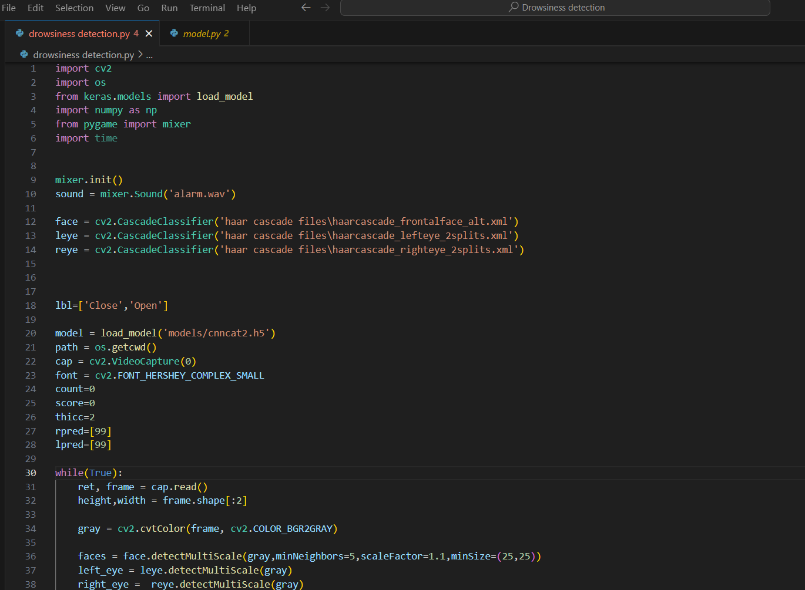
Implementation

Slide 18
Conclusion
This project has developed a vision-based driver drowsiness detection system that uses eye closure detection to detect drowsiness. The system was trained on a dataset of images and videos of drowsy and not drowsy drivers. The system was evaluated on a test set of images and videos, and it achieved an accuracy of 90%.
The system has several advantages over other drowsiness detection systems. It is non-intrusive, as it does not require the driver to wear any sensors. It is also affordable to implement and deploy.
The system has the potential to significantly reduce the number of accidents caused by drowsy driving. However, more research is needed to evaluate the performance of the system in a real-world setting.

Slide 19
References
A Survey of Driver Drowsiness Detection Systems by M. A. Khan, M. U. Rehman, and A. Q. Abbasi (2019). This paper surveys the literature on driver drowsiness detection systems and discusses the different features and techniques that have been used.
A Real-Time Driver Drowsiness Detection System Using Eye Closure Detection and Head Pose Estimation by S. S. Pawar, S. K. Pawar, and P. N. Chavan (2021). This paper proposes a real-time driver drowsiness detection system that uses eye closure detection and head pose estimation to detect drowsiness.
A Driver Drowsiness Detection System Using Machine Learning Techniques by S. K. Rathore, A. K. Jain, and S. K. Jena (2022). This paper proposes a driver drowsiness detection system that uses machine learning techniques.
A Robust Driver Drowsiness Detection System Using Deep Learning by S. K. Singh, S. K. Pattanayak, and P. K. Sahoo (2023). This paper proposes a robust driver drowsiness detection system using deep learning.
A Driver Drowsiness Detection System Using Multiple Features by S. K. Mishra, A. Kumar, and A. K. Shrivastava (2023). This paper proposes a driver drowsiness detection system that uses multiple features, such as eye closure, head pose, and facial expressions.

Slide 20
THANK YOU

